Slide 1

DATAMINING Project Third Review
Student Academic Performance Prediction & Attendance Impact Analysis
Presented by:
N. Renuka Sri Hasini (24B11A1299) Anurag Nayak (24B11A1014)
Department of Artificial Intelligence & Machine Learning

Slide 2


1. Abstract
2. Introduction
3. Analysis
4. Data Description
5. Preprocessing
6. Algorithms
7. Results
8. Conclusion

Slide 3

Educational institutions generate large student data
Attendance and performance are not analyzed together
Leads to "Attendance-Performance Gap"
No early prediction system for student failure
Proposed system uses Data Mining techniques
Predicts student performance in advance
Helps in early academic intervention

Slide 4

Student data is increasing rapidly
Includes attendance, marks, assignments
Traditional systems only store data
No predictive analysis is done
Educational Data Mining (EDM) helps extract insights
Project builds a prediction system for student performance

Slide 5

Reactive approach (after failure)
Manual data analysis
No prediction of performance
Data stored but not utilized
Decisions based on assumptions

Slide 6
Limitations of Existing System:
No early identification of weak students
Time-consuming manual tracking
Cannot analyze multiple factors together
No accurate prediction system
Delayed academic intervention

Slide 7
Proposed System
Data-driven prediction system
Uses student attributes:
Attendance
Study Hours
GPA
Assignments
Applies machine learning algorithms
Predicts:
Fail / Pass / Distinction
Provides early warning system

Slide 8
Advantages of Proposed System
Early identification of at-risk students
High prediction accuracy
Reduces manual effort
Data-driven decision making
Improves academic performance
Supports faculty intervention

Slide 9


Dataset contains student academic data
Each row = one student
Attributes include:
Attendance Percentage
Study Hours
GPA
Assignments
Participation
Target:
Final Grade (Fail / Pass / Distinction)

Slide 10

Raw data is not clean
Preprocessing improves accuracy
Steps:
Removed irrelevant data (Student ID)
Handled missing values
Converted categorical data
Normalized numeric values
Removed outliers

Slide 11
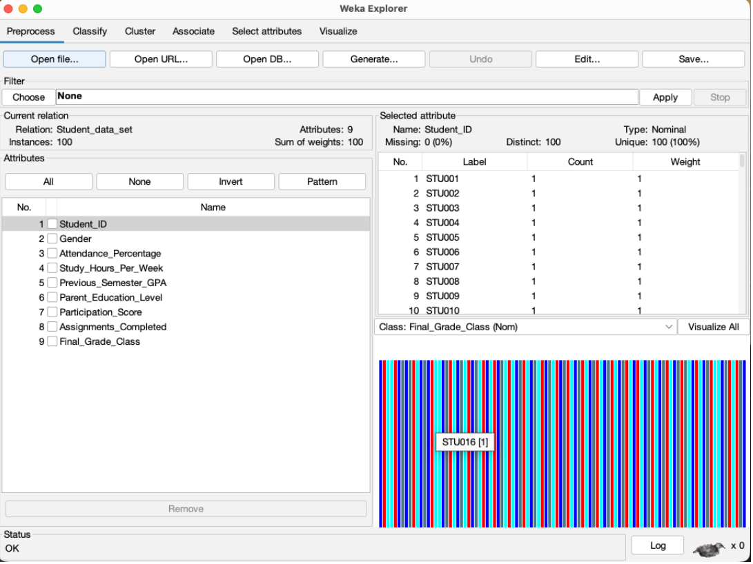
Before Preprocessing
Missing values present
Duplicate records exist
Data not structured
Not suitable for ML models

Slide 12
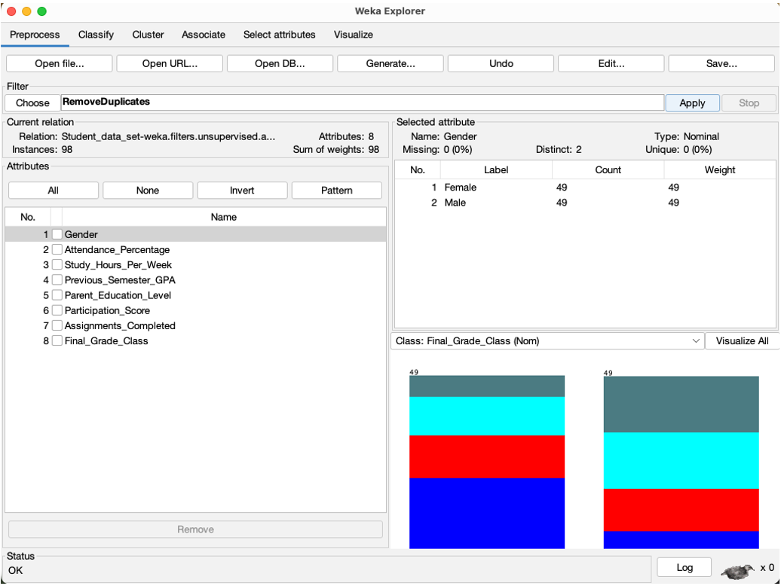
After Preprocessing
Clean dataset
No missing values
Structured data
Normalized values
Ready for model training

Slide 13
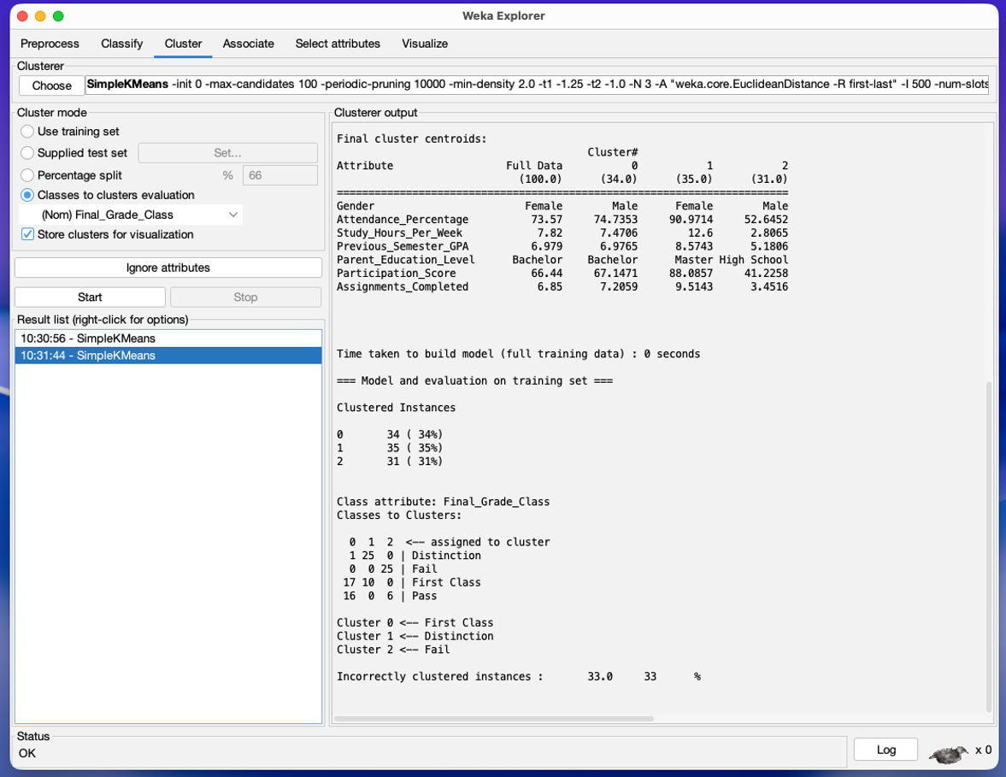
CLUSTERING (K-Means)
Used for grouping students
Creates "Learner Personas"
Clusters:
High Achievers
Average Students
At-Risk Students
Helps identify hidden patterns

Slide 14

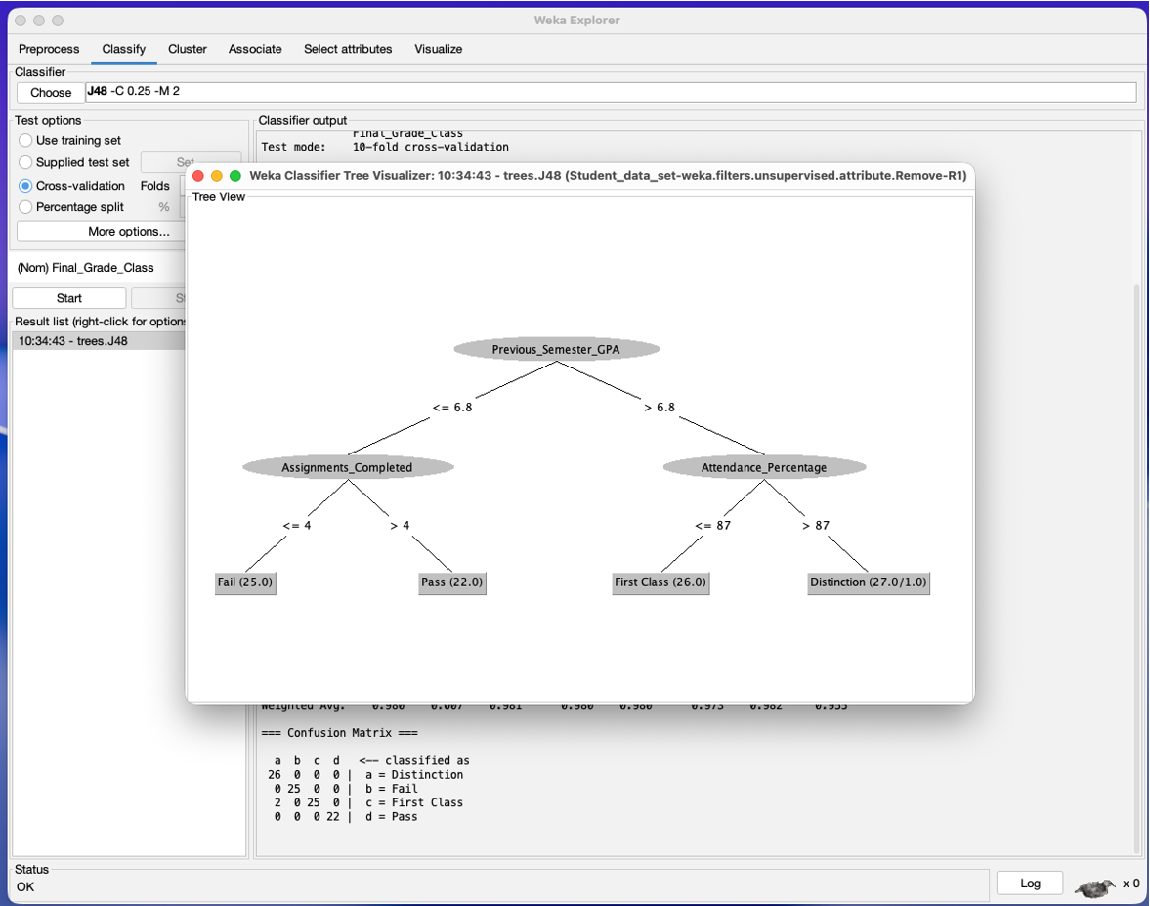
Predicts final student performance
Based on:
Attendance
GPA
Assignments
Output:
Fail
Pass
Distinction
Easy to understand decision rules

Slide 15

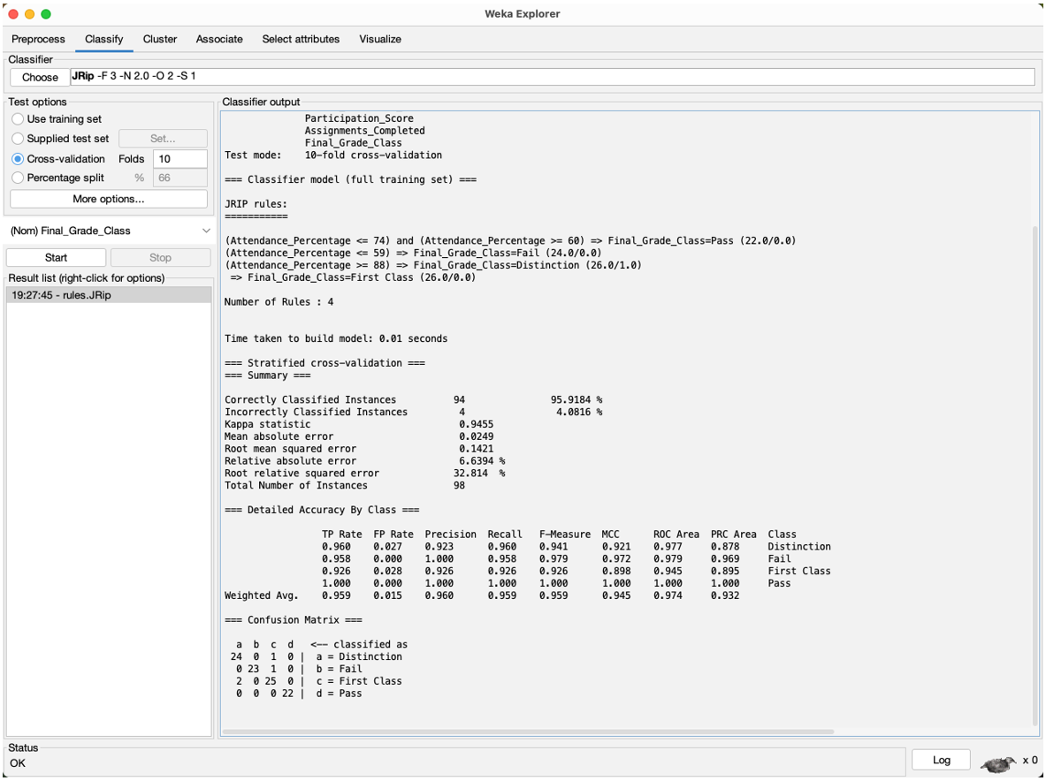
RULE-BASED MODEL (JRip)
Generates IF-THEN rules
Easy for faculty to interpret
Example:
IF attendance < 60% → Fail
IF assignments > 4 → Pass

Slide 16
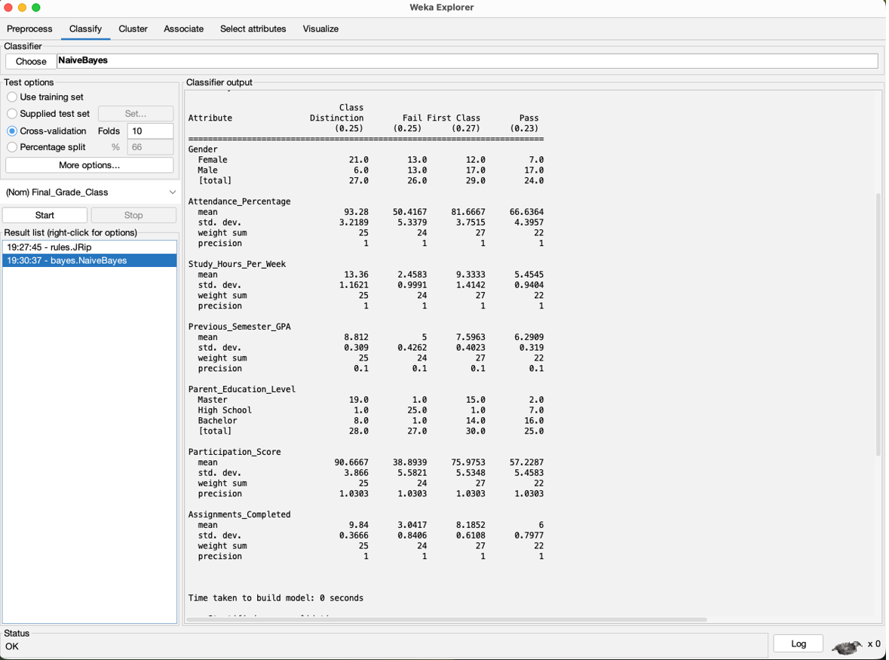
NAIVE BAYES
Probabilistic classifier
Based on Bayes Theorem
Calculates probability of
outcomes
Fast and simple model

Slide 17
RESULTS (Clustering Output)
High Achievers:
High attendance
High study hours
Average Students:
Moderate performance
At-Risk Students:
Low attendance
Low study hours

Slide 18
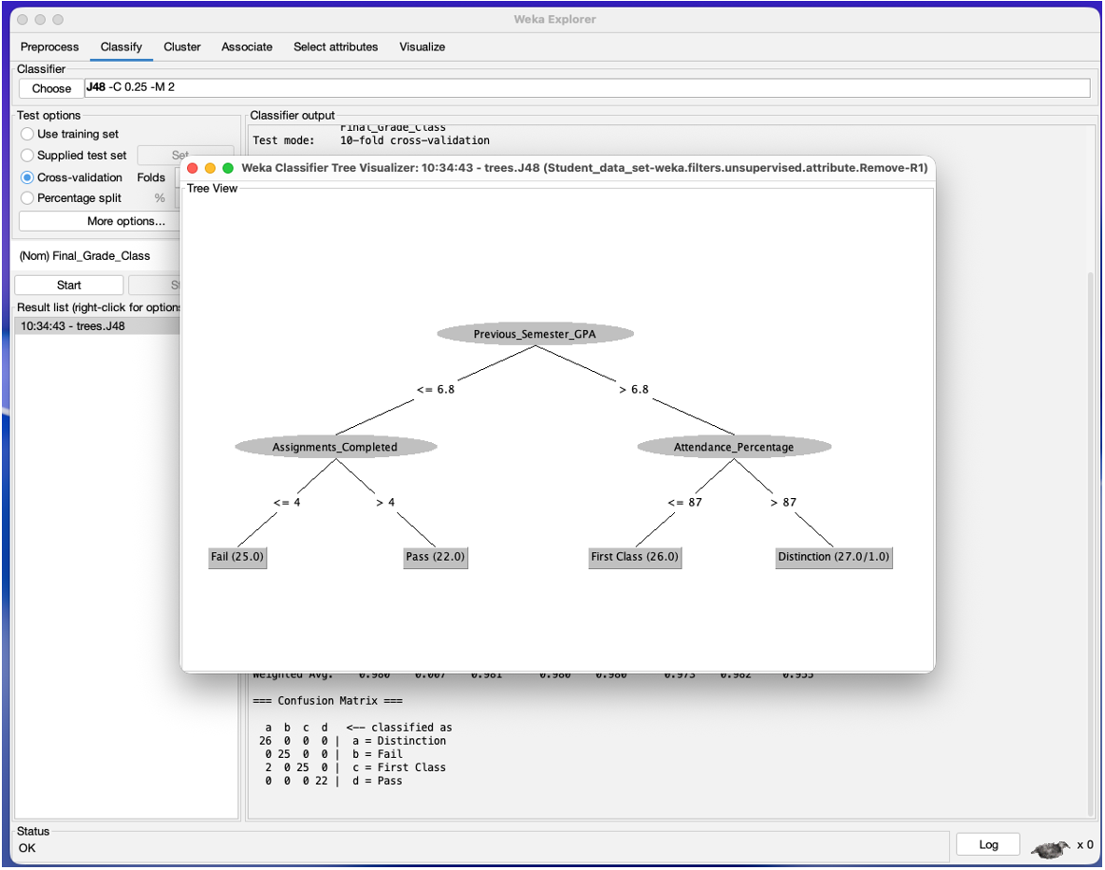
RESULTS (Decision Tree)
GPA is main factor
Attendance affects distinction
Assignments affect pass/fail

Slide 19
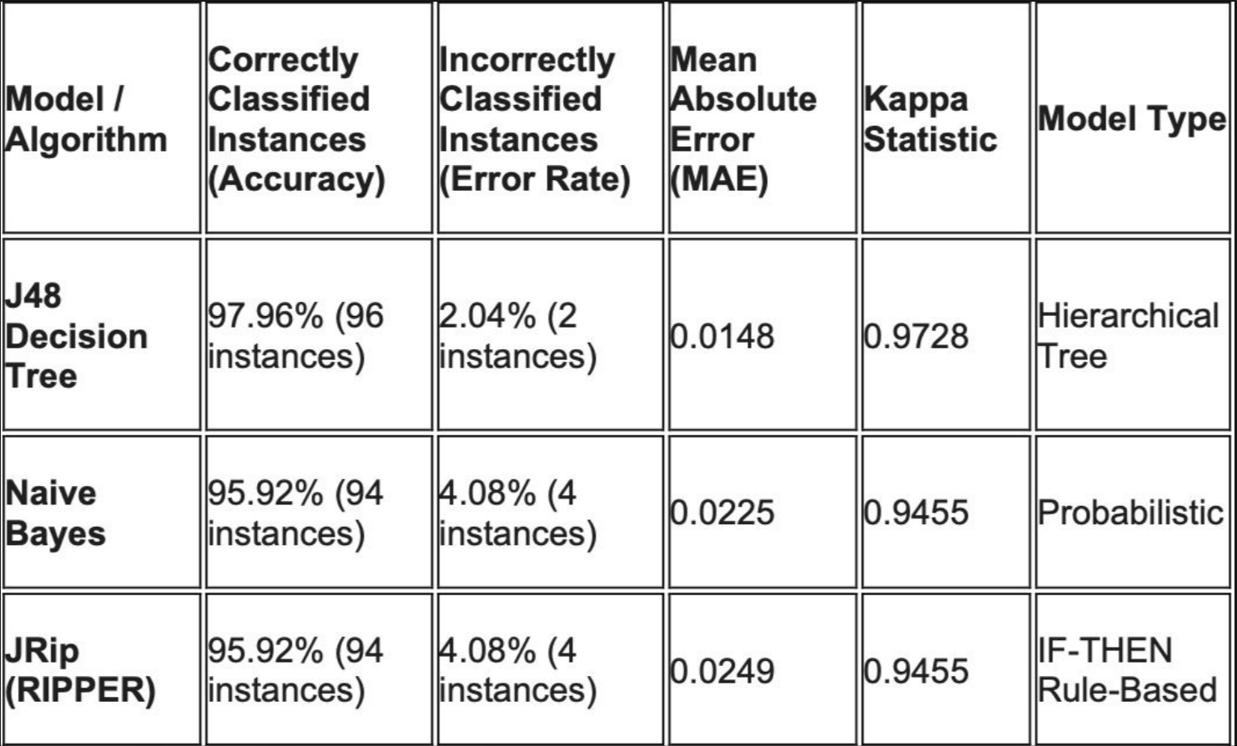
MODEL COMPARISON

Slide 20

Successfully predicts student performance
Bridges Attendance-Performance Gap
Helps early identification of weak students
Improves academic outcomes
Supports data-driven education system

Slide 21

THANK YOU

